Slide 1
Project Pitch
Charles Christianson
SEIS744 Internet of Things

Slide 2
Idea – Smart Pollution Mask
I wanted to build on the idea of the Smart Pollution Mask. Originally an idea for an unbounded exercise, the challenge is to determine a real, workable solution
Proof-of-concept type project – can I build a sensor/processor/communication apparatus that could be fitted to a mask.
Due to time, skill, and budget limitations, my focus for this class will be on the electronic circuit and data path from device to cloud.
Background
Air pollution is a serious concern in many parts of the world
Extreme pollution can be dangerous, but even less obvious pollution can have serious health consequences
A variety of Masks exist, but they do not tell you when you should be wearing them.
Alternatives
Could the sensor/indicator be separate/attachable? (ie. Wearables – like a pendant or wristband?)
What about Commercial/Industrial/HazMat applications? Higher budget (but higher cost/criticality)

Slide 3
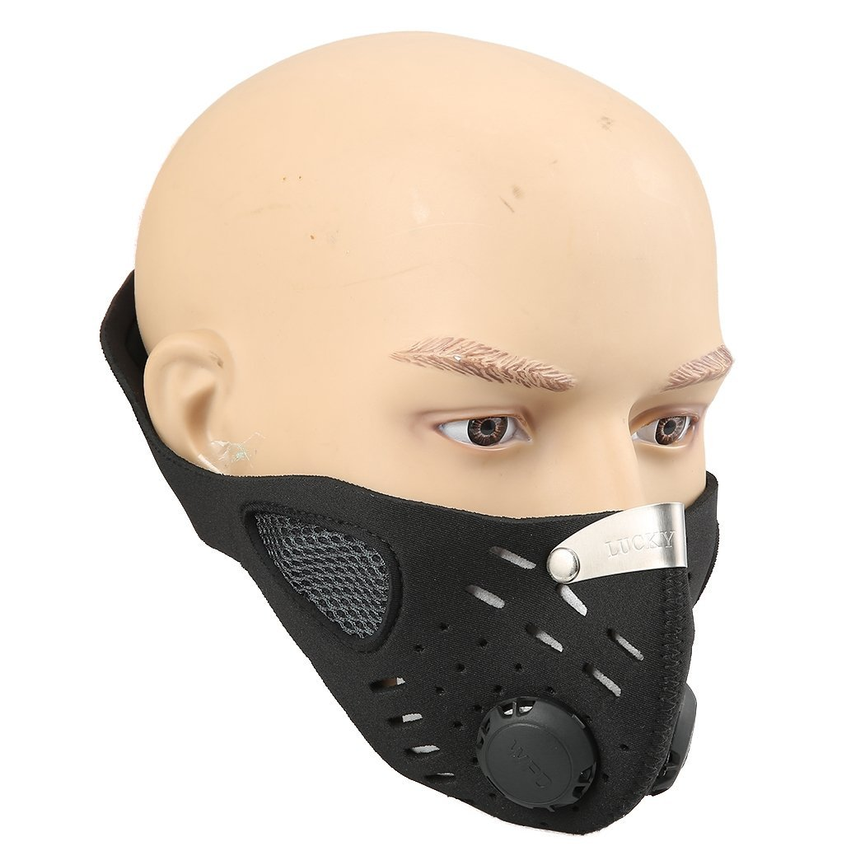
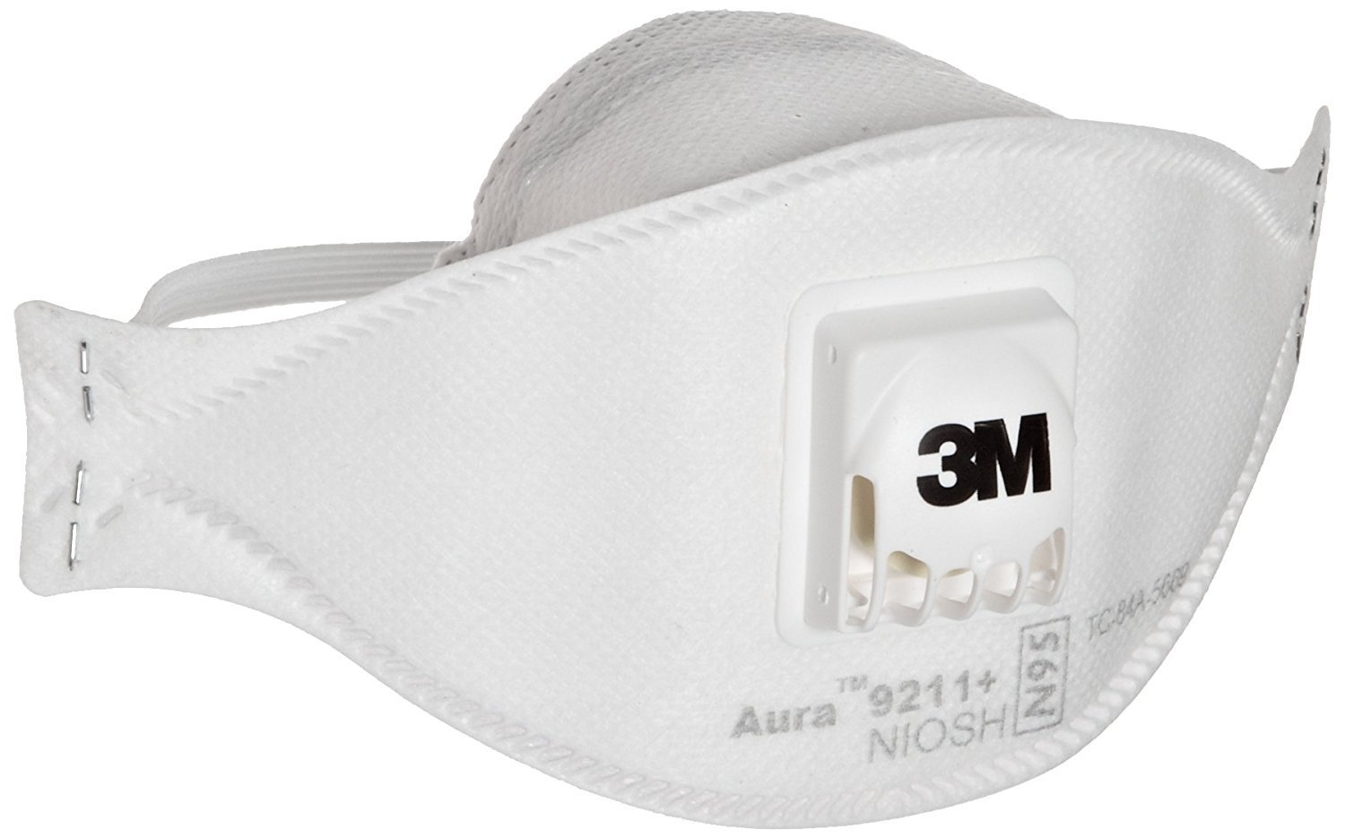
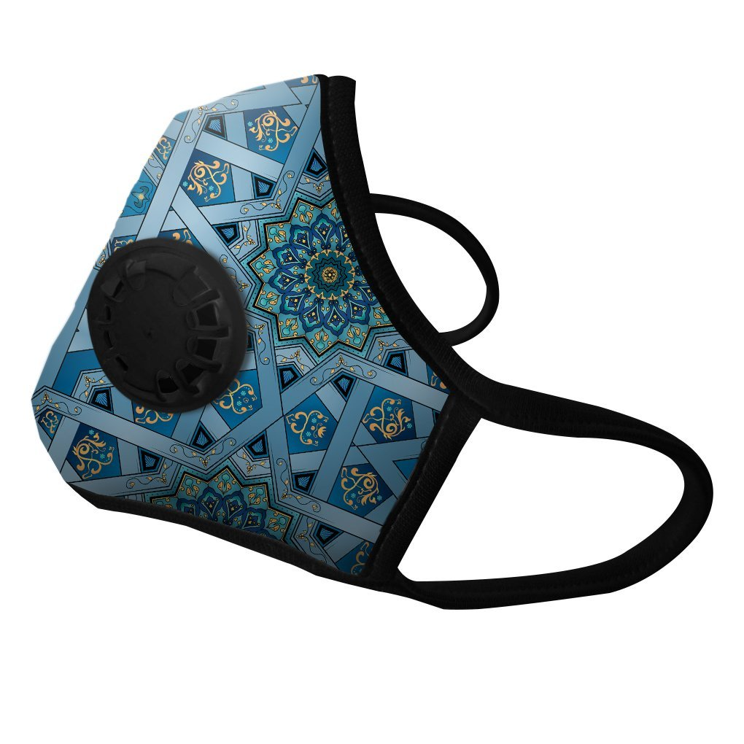
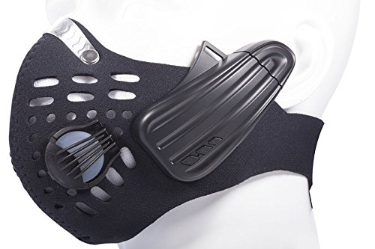
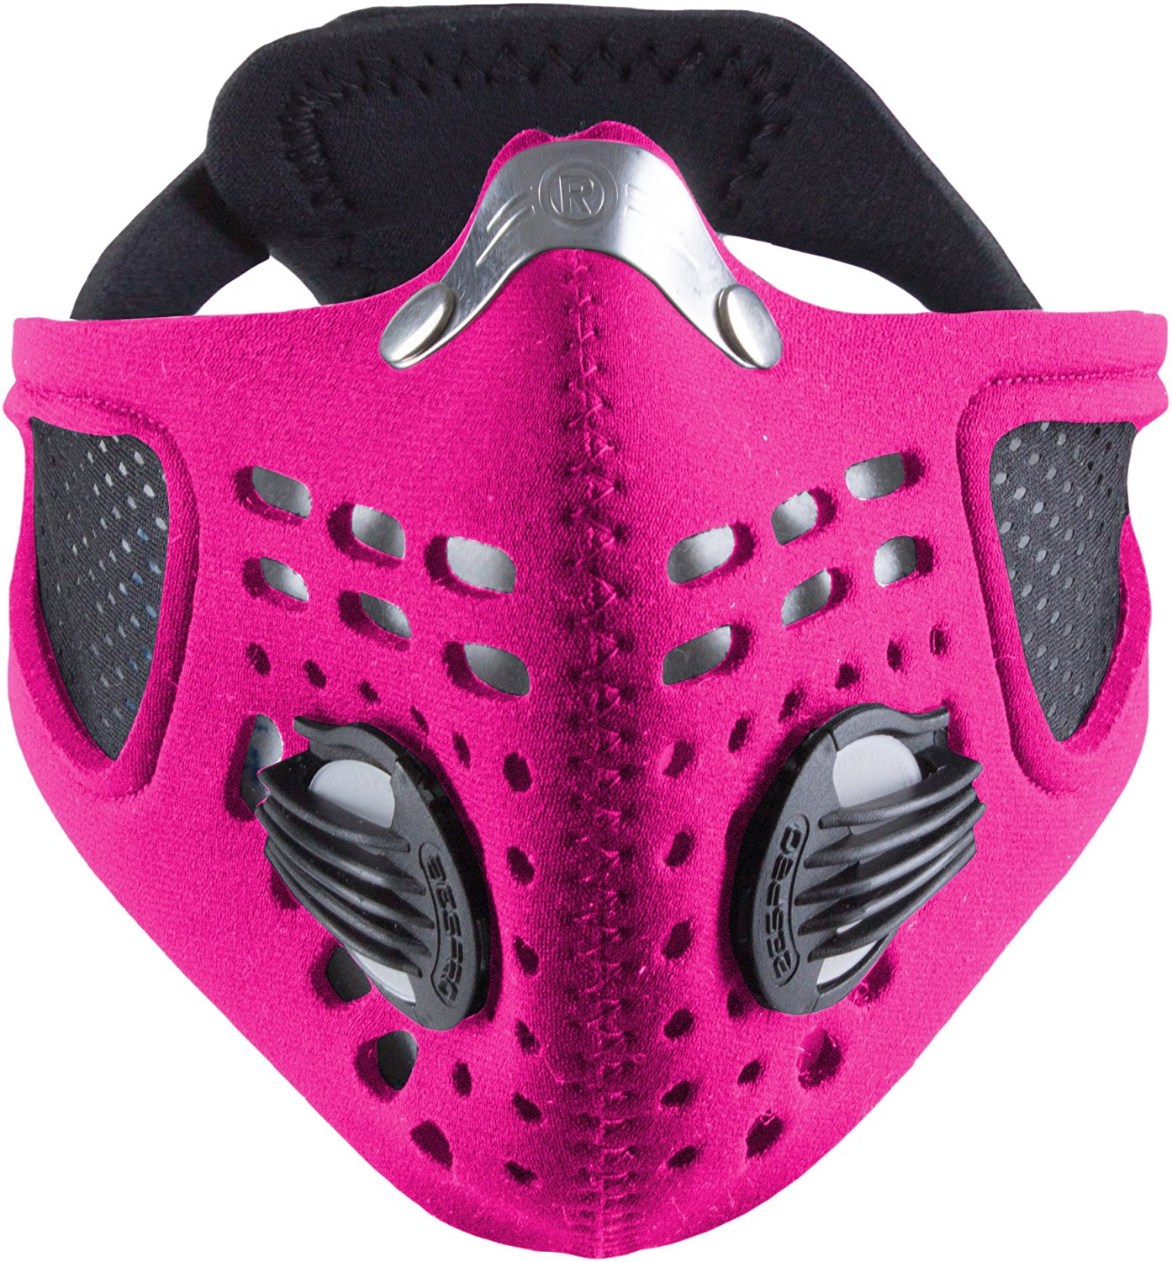
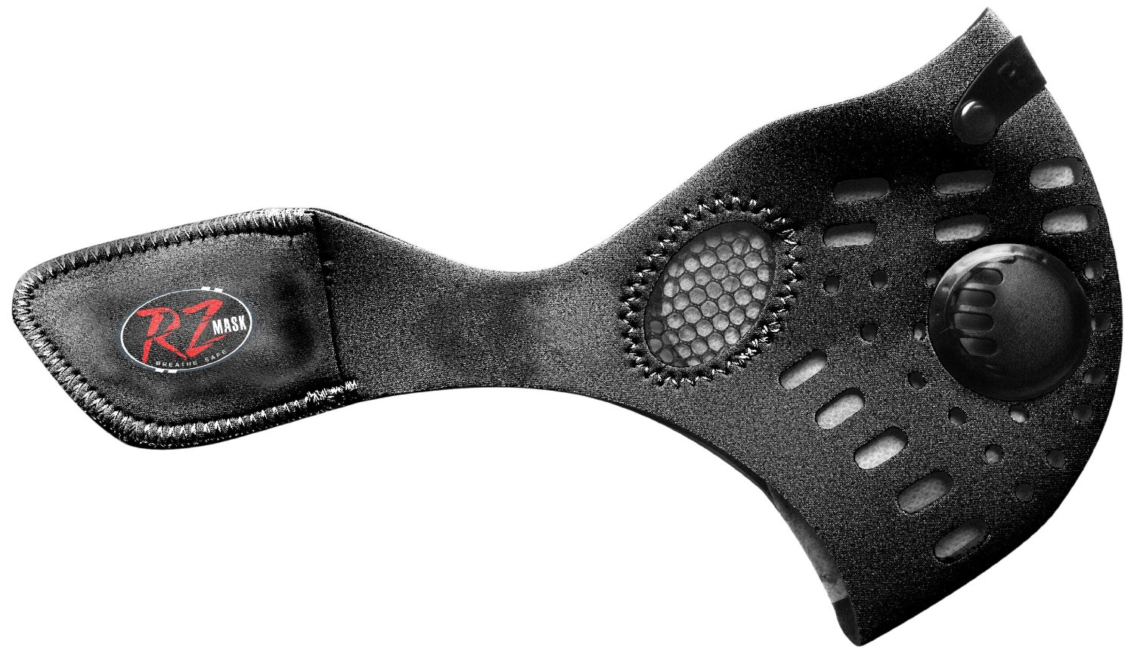
Common Mask Types/Styles
Leeko Anti-dust Anti-pollution Mask
Vogmask Chakra N99 CV
3M Aura cAuBU Particulate Respirator
Boblov 2-In-1 Wireless Cycling Anti-Pollution Mask
& Bone Conduction BT Bluetooth Stereo Headphone
RZ Dust/Pollution Mask
Respro Sportsta Face Mask

Slide 4
Features/ Behavior
Personal Air quality indicator (This indicates air quality based on the Mask sensors)
Simple – Green/Yellow/Red LEDs
Local Air quality indicator
Even simpler – binary indicator (Take or don’t take) “Blue Glow” or something similar
Rely on Internet API (decision made in the cloud – based on external air quality API sites)
Collect personal air quality data (including quality data, location, device identifier, date/time) and send to the cloud
Available for User to track exposure/ quality
Used to augment Air Quality data (In a way that is not personally identifiable)

Slide 5
Design Constraints
Electronics should be
Small physical size/ weight
Low Power / very low power
Reasonable Cost: Need to manage cost increase relative to value add- premium mask seem to be better target
Durable (Washable??)
Software / Data
Sensitive user data must be protected
Device must be safely transferable (not possible to “inherit” someone else's data, nor pollute previous user’s data)
Secure-by-default – minimize attack surface
Costs
price from ~$10 to upwards of $150 – need to determine correct parts budget

Slide 6
Hardware
Sensors
1 or more Air Quality Sensors (such as CO, Lead, NO2, O3, PM10, PM2.5, SO2, etc.) https://www.epa.gov/air-trends
Spec Sensors look promising (low power, small, light, but expensive) https://www.spec-sensors.com
Sensors to indicate if Mask is being worn (circuit sensor/contact switch?)
Some kind of off/ standby switch, and a Clock
Geolocation? GPS module, Wi-Fi, or offload to smart phone?
Power
Low power – ideally 3.3 volt range, low consumption
Lion/li-poly or lithium coin (still need to do the calculations)
Ideally, rechargeable battery, or replaceable consumer grade cells (but need to watch cost and lifespan)
Storage
Some low cost flash storage for data accumulation (e.g. micro-SD or embedded)

Slide 7
Hardware (Continued)
Microcontroller – TBD, but goal to keep requirements low to support power budget
Connectivity – Two main options
Bluetooth Low Energy (BLE) via Smart phone, etc.
Smaller module, lower cost, exploit user’s cellular internet and Geolocation features
Depends on Phone, more complex software, needs microcontroller (probably)
User (or smart phone at least) proximity detection?
Cellular / Wi-Fi (e.g. Particle Electron / Photon)
Device can be independent, simpler software stack, no need for separate microcontroller
More expensive (cellular), Wi-Fi connectivity challenges, data plans, geolocation
Combinations? Each connectivity type has advantages – consider the Apple Watch (Wi-Fi + Bluetooth)

Slide 9
Software & DATA
Device should
Determine if “take me” indicator should be active (and possibly at what intensity) from internet API (Note: this should be a custom API that handles the logic – the device should be relatively simple to reduce power needs)
Collect sensor data and transmit to cloud (possibly via smartphone as intermediary) – Cache locally in case of outage/offline use
Use data from masks to build database to support enhanced air quality information (in such a way that it doesn’t compromise privacy or security)
Cloud Services should
Receive location data and return air quality index (possibly the nominal “Air Quality Index” or some custom value)
Receive sensor / device data and store data points to cloud DB (associated with correct user)
Provide a portal for user to view/ manage device data
Phone App (if needed) Should
Collect data from device and forward to cloud when available (both links may be transient) – Provide additional data as needed (ie geolocation, User Account ID)
Forward requests for Air Quality Index for area to device so indicator can function
Portal to data?

Slide 10
Air Quality APIs
Breezeometer.com
Commercial License
Different Pricing/Service levels (Free Trial)
International?
Uses Latitude and Longitude
AirNow API – EPA supported service with data from US, Canada, and Mexico
Public License
North America focused
AccuWeather Aire Quality API
Commercial License
International (But seems focused on Korea and China)
AirVisual – Weather, Air Quality (AQI) and pollution API
Tiered commercial license (includes free Tier – 10K r/m, 1M r/m, 10M r/m)

Slide 11
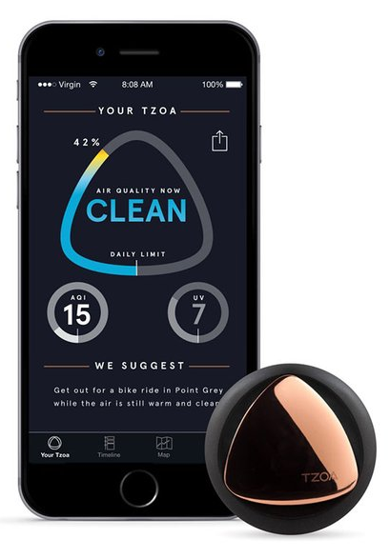
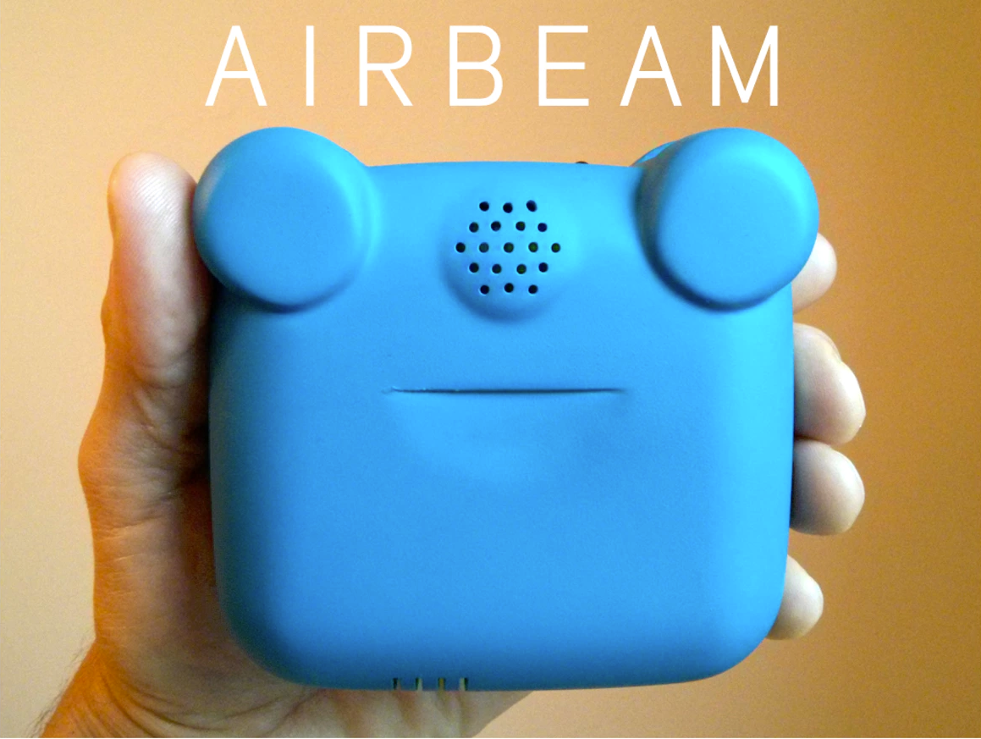
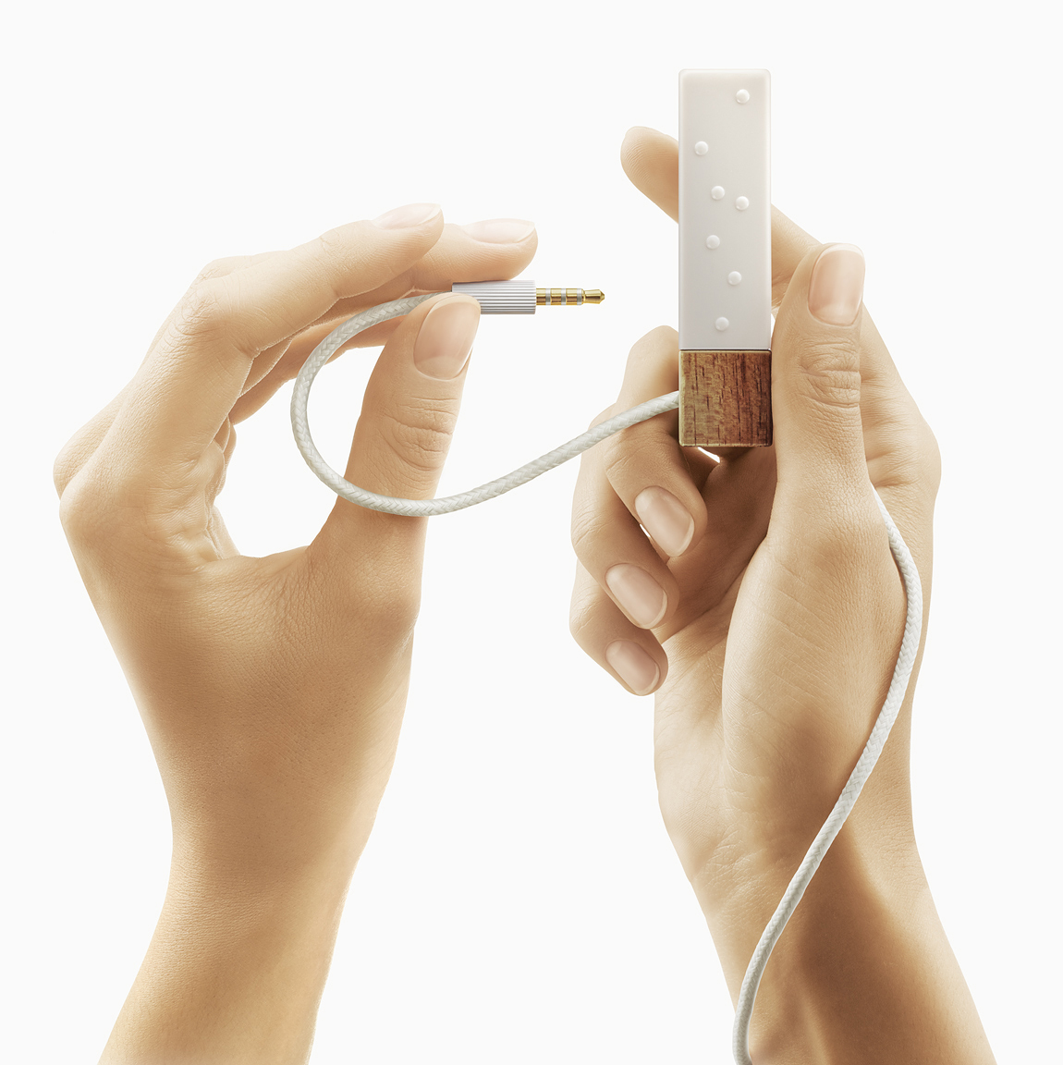
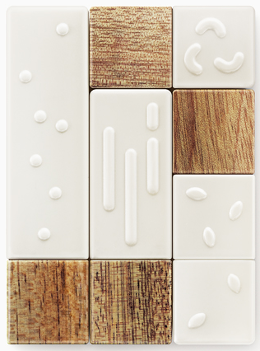
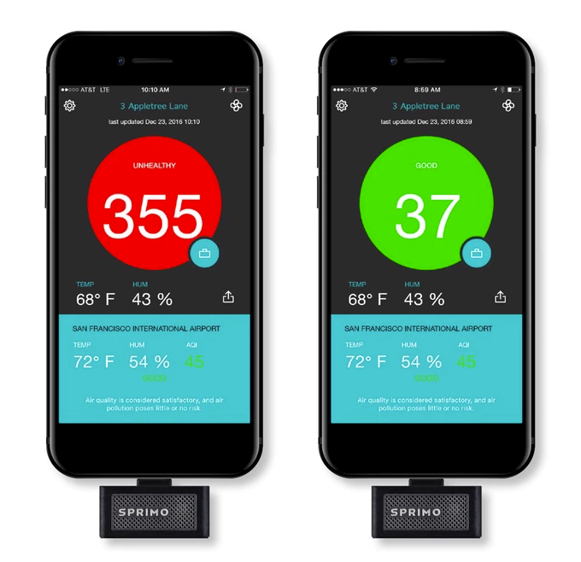
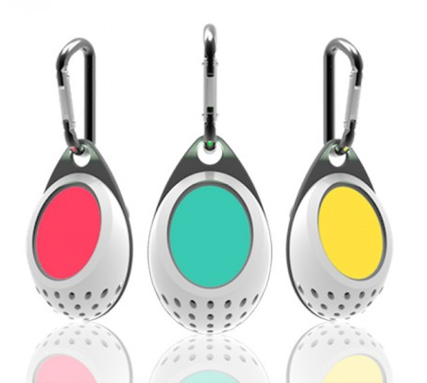
Existing and upcoming Devices “in the Wild”
TZOA
Air Quality, Temp, Humidity, light, UV
Lapka (Personal Env Sensors – not pollution)
Sprimo Personal Air Monitor
Clarity air quality monitor

Slide 12
Challenges
Hardware
Effectiveness and durability of available sensors unknown
Cross-sensitivity can distort results (can be compensated for with multiple sensors – but increases size, power, cost)
Cost – effective sensors can be expensive – cost needs to be driven down
Legal/Regulatory
Intellectual Property – Either need to partner with Mask / air filtration company or develop IP safe solution
Public Safety – regulations – Can a user rely on device? Is there liability?
Data
Indoor vs Outdoor quality (if you are indoors, the air quality may vary dramatically from outdoors, either better or worse.)
Market Acceptance
Find the correct price point
Target market may be international – (Urban China? Combination of high pollution with increasingly wealthy style conscious consumers)
Competitive products

Slide 13
References
Amazon.com (Search for these items)
RZ Dust/Pollution Mask w/2 Laboratory Tested Filters, Model M1, Black, Size Regular/Large
Leeko Anti-dust Anti-pollution Mask,Half Face Ski Snowboard Bike Motorcycle Cycling Mask - Free Size
Boblov 2-In-1 Wireless Cycling Anti-Pollution Mask&Bone Conduction BT Bluetooth Stereo Headphone
3M Aura Particulate Respirator 9211+/37193(AAD) N95, Stapled Flat Fold Disposable, Exhalation Valve
Vogmask Chakra N99 CV (Medium 51-130 lbs/23-58 kg)
Common Pollutants: https://www.epa.gov/air-trends
Spec Sensors: https://www.spec-sensors.com

